Slide 1
ERP
Enterprise Resource Planning System

Slide 2
What
is
ERP ?

Slide 3
PURPOSE OF ERP
INTREGATION
Integration of purchasing, human resources, production, sales, and accounting data into a single system
I
ALLOW THE REAL TIME
Allow real time global updates of transactions
A
E
ENABLE
Enable critical business decisions using latest data.
S
SHOW DIGITAL DASHBOARD
Show data to Digital Dashboard for Dicision som Challenge

Slide 4
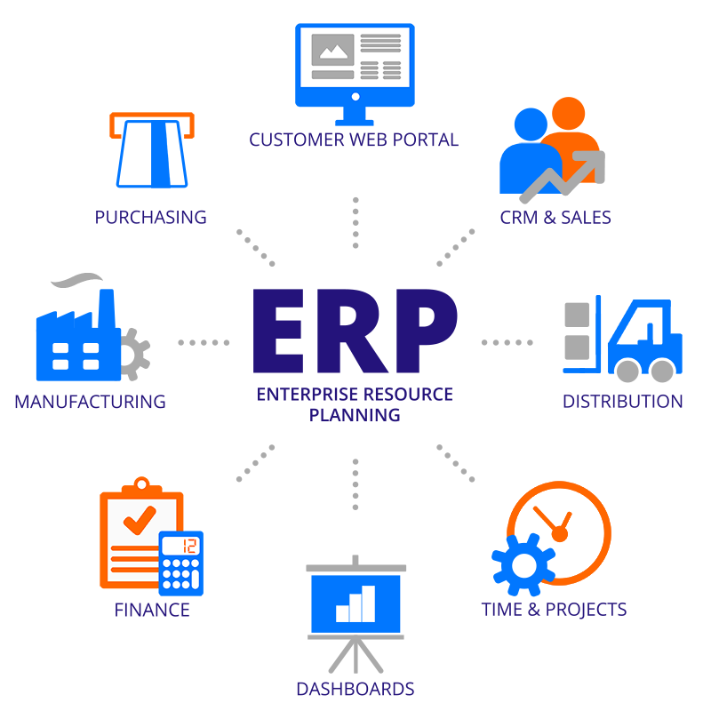

Slide 5
Software
Of
ERP

Slide 6





Software of ERP
SAP
Oracle Application
Infor Global Solution
The Sage Group
Microsoft

Slide 7
Manual
And
Automation

Slide 8
Manual and Automation ( ERP )
Manual
Automation
Incorrect Order
Old data
Too much time
Have planning when have some problem
Correct Order
Latest Data
Better time
Automation
Manual

Slide 9

CASE STUDY

Slide 10
1. SUMMARY

Slide 11
2. Name’s ERP

Slide 12
3. Solution & Purpose

Slide 13
4. What is the key in ERP system
to be successful

